Slide 1
Computer Vision
Advanced CNNs

Slide 2
This Week’s Agenda
Quiz Review!
More Modern Image-Network Architectures
Mitigating vanishing gradients in deep networks.
Image-to-Image Prediction Tasks
Image segmentation, Image super-resolution.
Transpose convolution operations for up-sampling.
Visualizing What a CNN is Learning
Try to visualize what components of an image your model’s feature extractions are detecting.

Slide 3


Slide 4
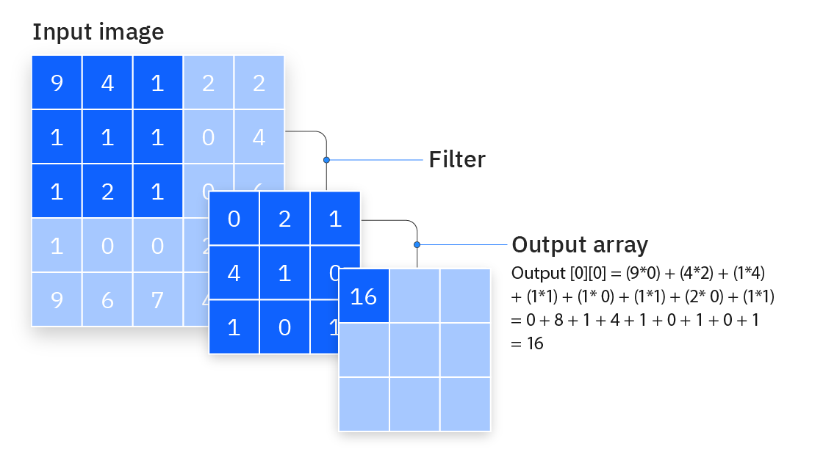
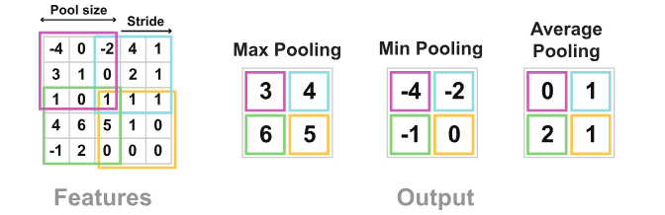
Quick Review
Convolution Operation
Pooling Operation
Notes:
Unlike numeric prediction tasks, where you may find shallow networks perform well (because abstraction is difficult with relatively few features), with unstructured data, deeper networks tend to perform best (recall that these applications are where DL really began to shine in recent decades).

Slide 5
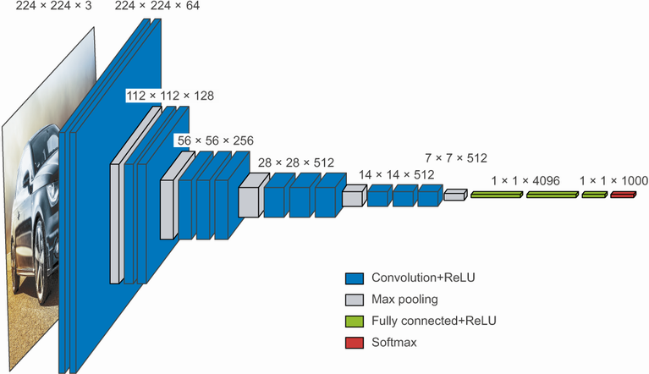
Image-Classification Architectures
Notes:
Unlike numeric prediction tasks, where you may find shallow networks perform well (because abstraction is difficult with relatively few features), with unstructured data, deeper networks tend to perform best (recall that these applications are where DL really began to shine in recent decades).

Slide 6
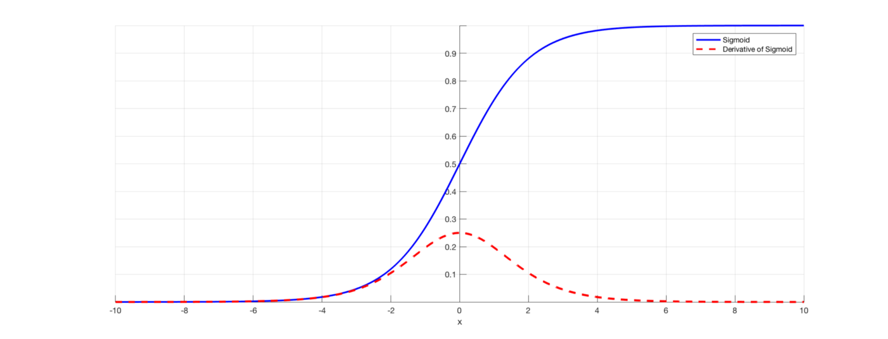
Vanishing Gradients
Recall That Certain Activations Make Vanishing Gradients More Likely
As we approach 0 or 1 at a node’s output, changes to input parameters have little impact...
However, Regardless of Activation This Can Be an Issue
For deep networks, parameters at front of network tend to have a much smaller influence on ultimate loss function. Accordingly, gradients for those early parameters can be very small.

Slide 7
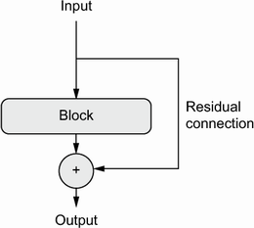
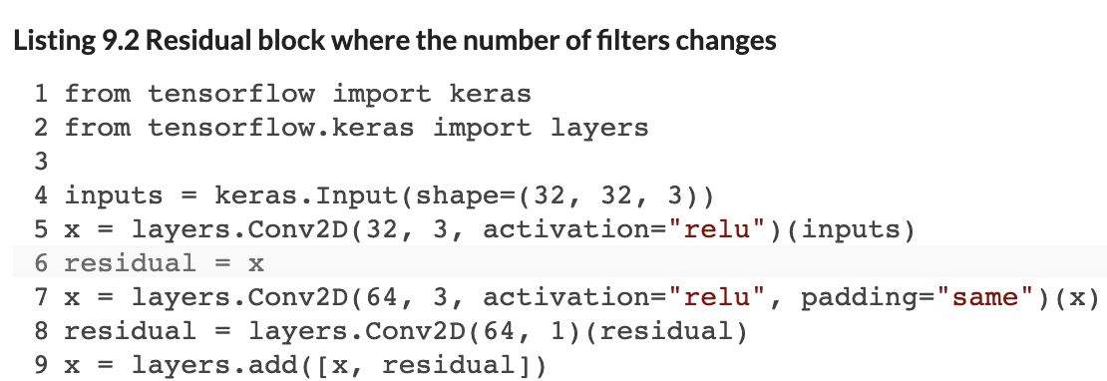
Solution: Residual Connections
Provide a ’Short-cut’ From Loss Function to Front-end Weights
We include feed-forward layers as usual, but we also add short-cut connections around the layers.
We typically incorporate these residual connections either via an ‘Add’ layer or a ‘Concatenate’ layer.
Note that conformity of the tensor shapes will be very important here – you’ll start encountering shape conformity errors if you are not careful!

Slide 8
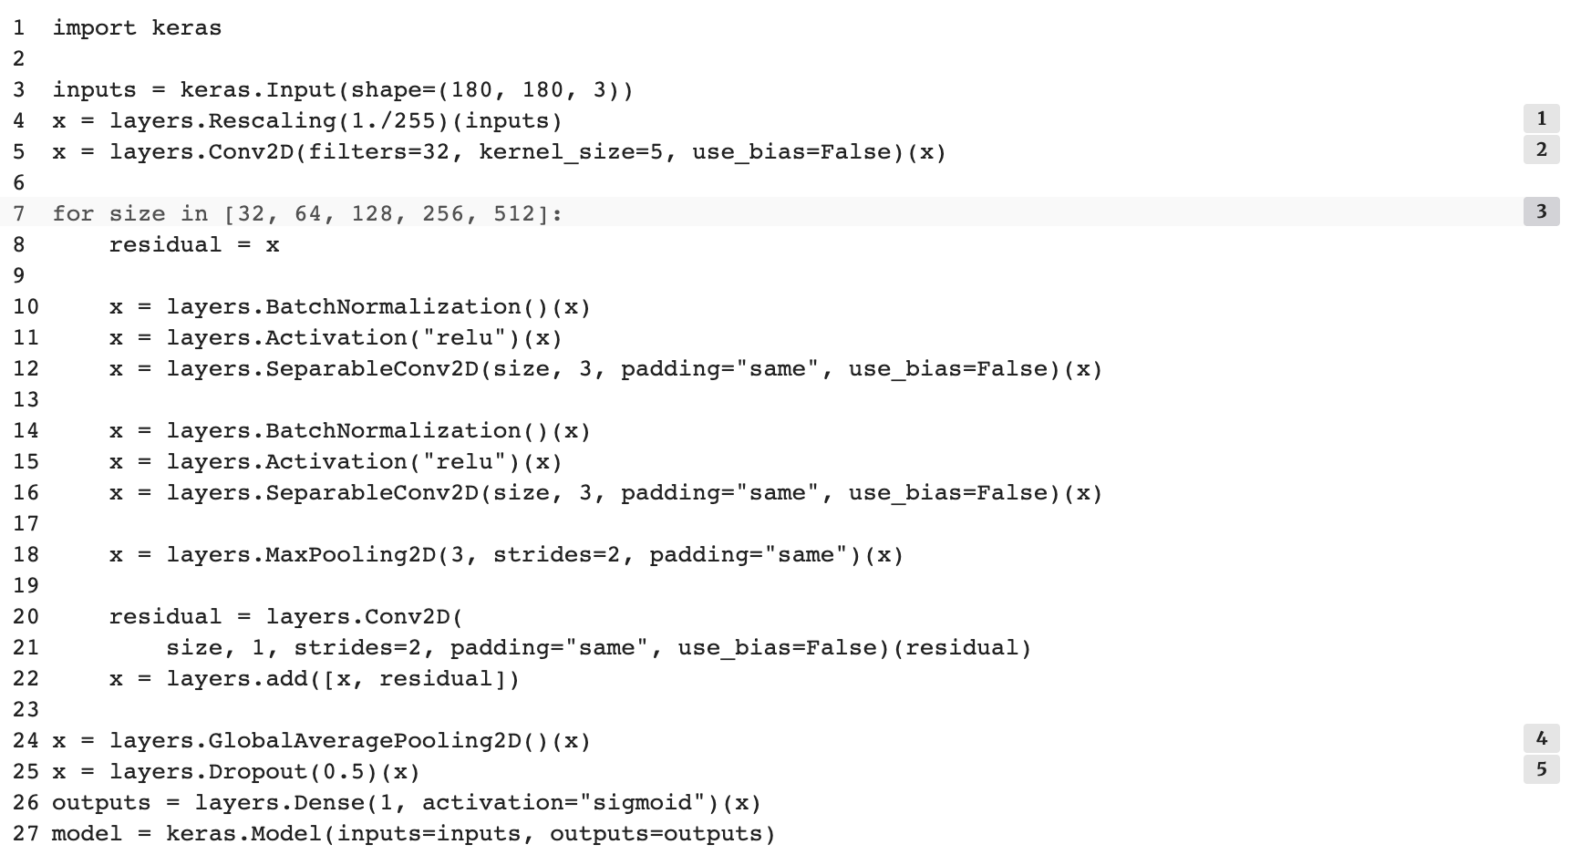
Other Modern CNN Innovations
Separable Convolutions = Independent Filters for Each Input Channel
Rather than sharing the filters across input channels (e.g., R, G and B), we create different filters for each channel.
Batch Normalization → Activation → Separable Convolutions + Residual
Rather than sharing the filters across input channels (e.g., R, G and B), we create different filters for each channel.

Slide 9
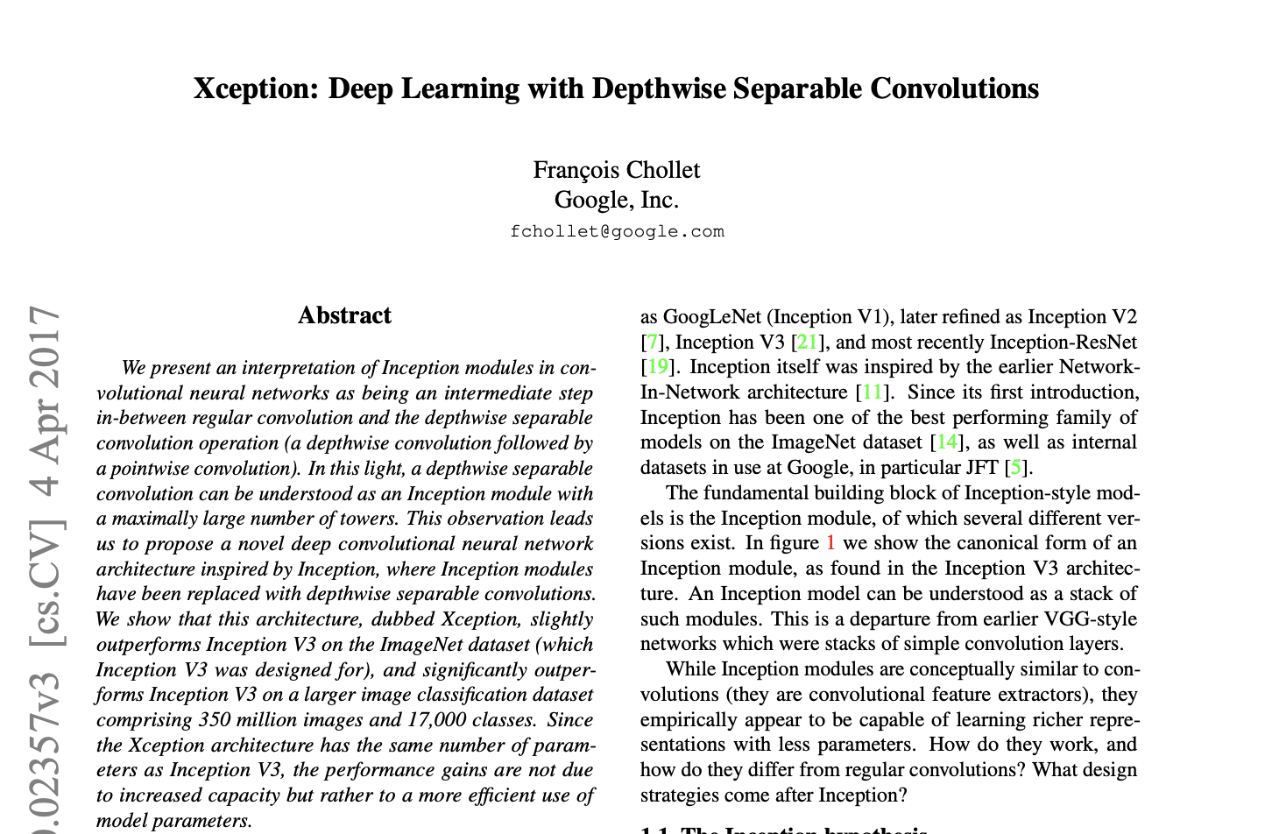
This is the Xception Architecture

Slide 10
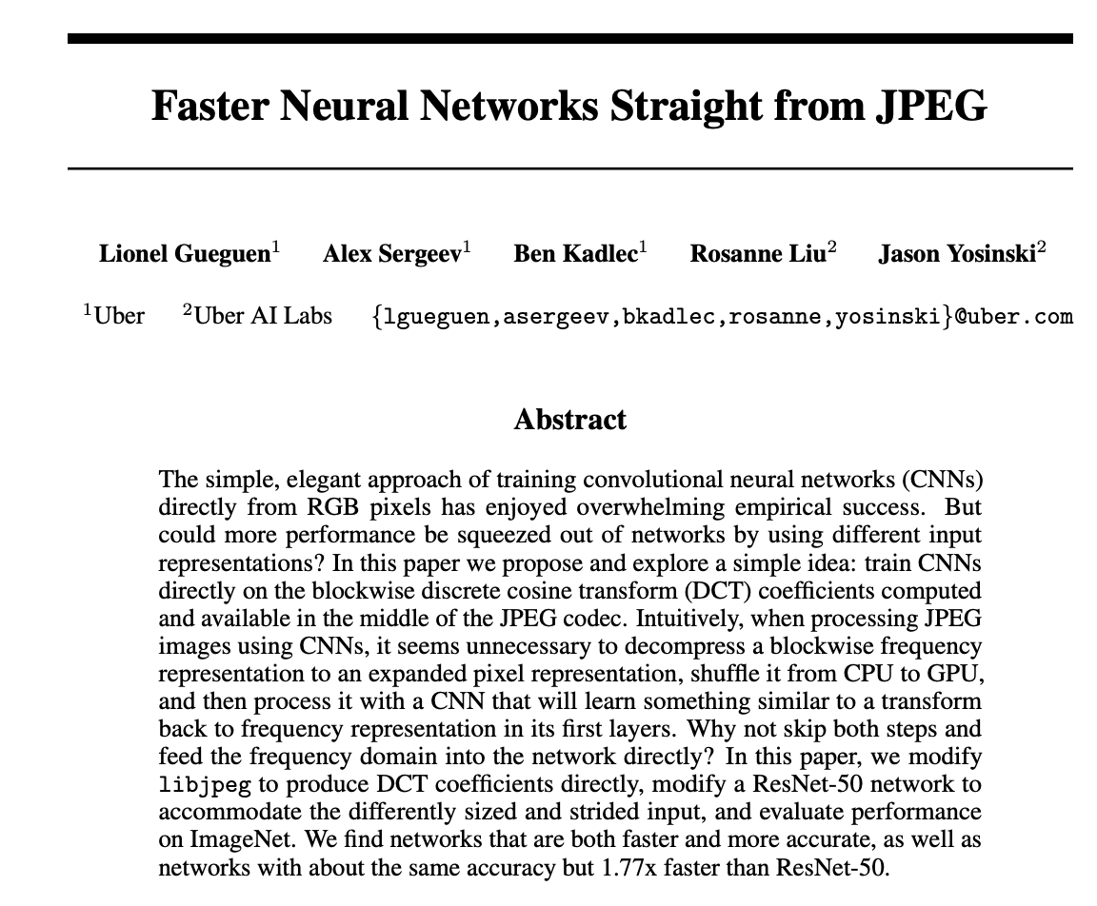
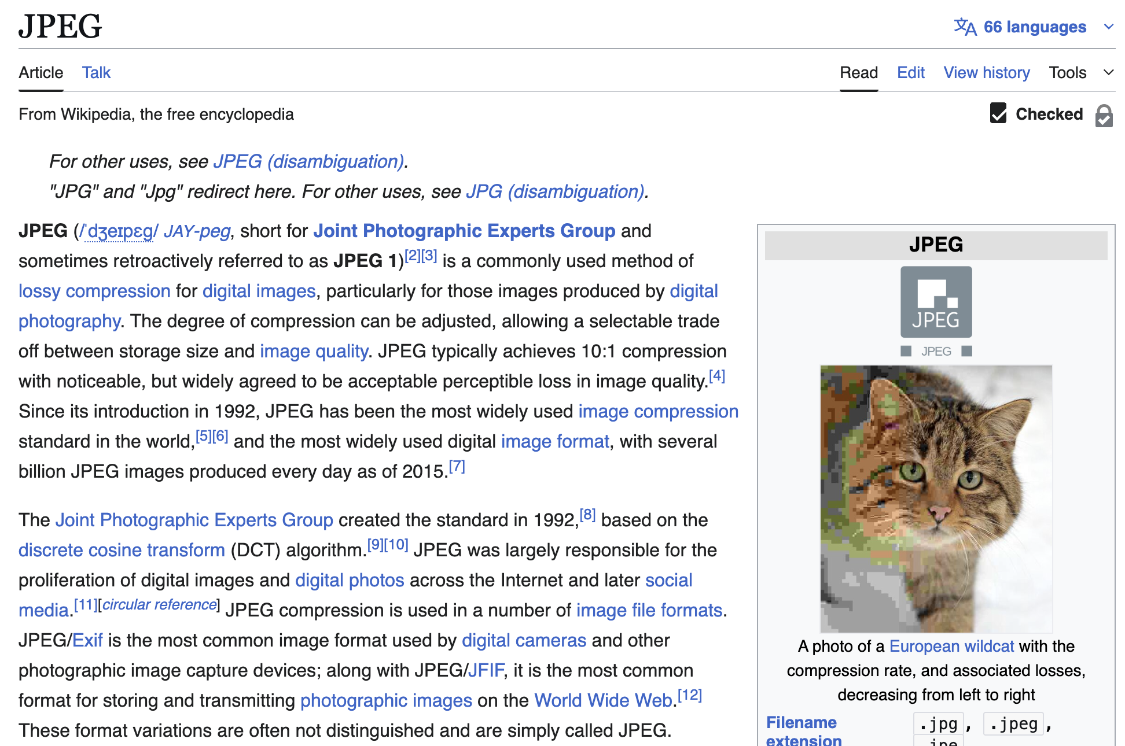
Computer Vision: Beyond Labeling
Example Tasks
Image-sharpening or 'super-resolution’
Image segmentation / bounding box prediction
Denoising (content removal)
Inpainting (plugging in missing pixels)
Data compression
Notes:
It could be linear, with MSE / MAE loss, or it could be a sigmoid, in which case the loss function could be binary cross-entropy.

Slide 11
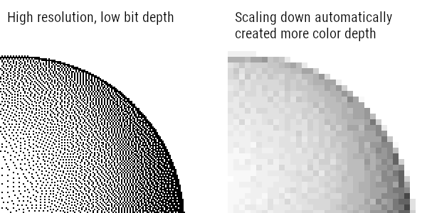
Image-to-Image Prediction
Super-Resolution
Take a high-resolution image, pixelate it, then try to predict the high resolution from the pixelated version.
Q: What kind of activation and loss function will make sense in this task?
Notes:
It could be linear, with MSE / MAE loss, or it could be a sigmoid, in which case the loss function could be binary cross-entropy.

Slide 12
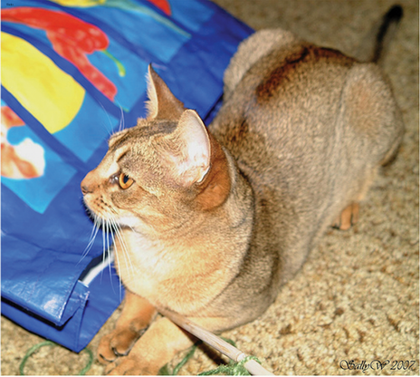

Image-to-Image Prediction
Image-Segmentation
Take an image and its segment mask, then try to predict the segment associated with each pixel from the original picture.
Q: What kind of activation function and loss function will make sense in this task?
Notes:
Softmax! This is a 3-class classification problem.

Slide 13
Topology for Image-to-Image
Auto-Encoder Architecture
Down-sample and then Up-sample back to same dimensionality
We do not use down-sample using pooling (because they force attention to the whole image as we learn higher level features). Instead, we use larger strides. This enables ‘dimensionality’ reduction while maintaining a focus on local portions of the image.
We then ‘up-sample’ back to the original dimensionality using a transpose of the convolutional operation. This is a form of autoencoder architecture.
Notes:
Softmax! This is a 3-class classification problem.

Slide 14
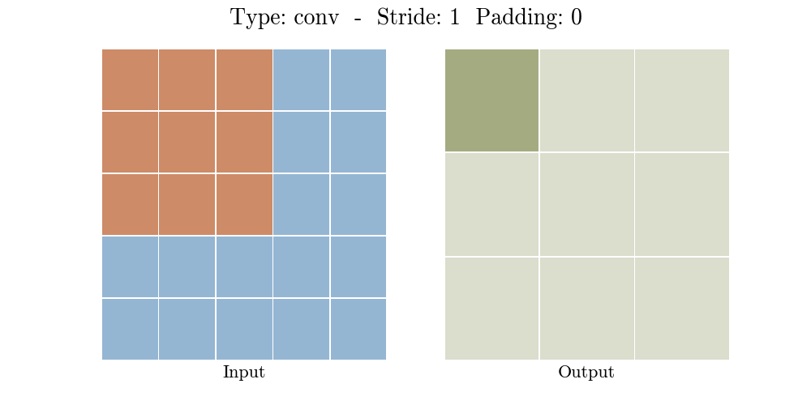
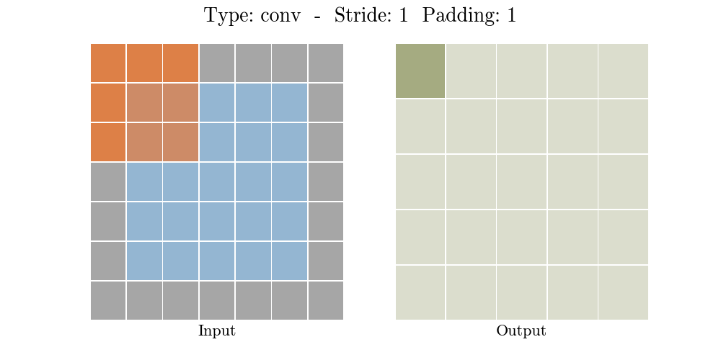
Convolution
Recall What A Convolution Is…
It’s a down-sampling approach (it compresses information)

Slide 15
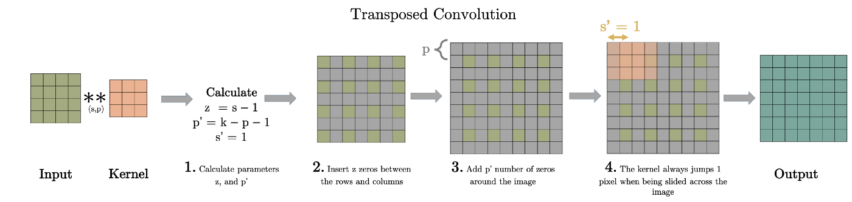
Inverse Convolution
Inverse of a Convolution
Instead of Input (+padding) * filter (+stride) = output, this calculates the inverse operation, to up-sample.
Here, s is the Convolution stride, p is the Convolution padding, k = is the Convolution kernel width/height; thus, s’ is the stride of the transpose convolution (always 1), z = padding around each pixel element, p’ is the final padding around the image for the transpose operation.

Slide 16
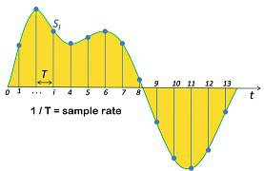
CNN for Audio
Same Sequence Concepts Work for Audio Data
Audio files are just sequences of numeric values (amplitude), possibly two if it was recorded in stereo.
Once we recognize this, we realize we can predict things about audio sequences too!
Notes:
This is skipgram on the right. One word to surrounding context words (we map input word to

Slide 17
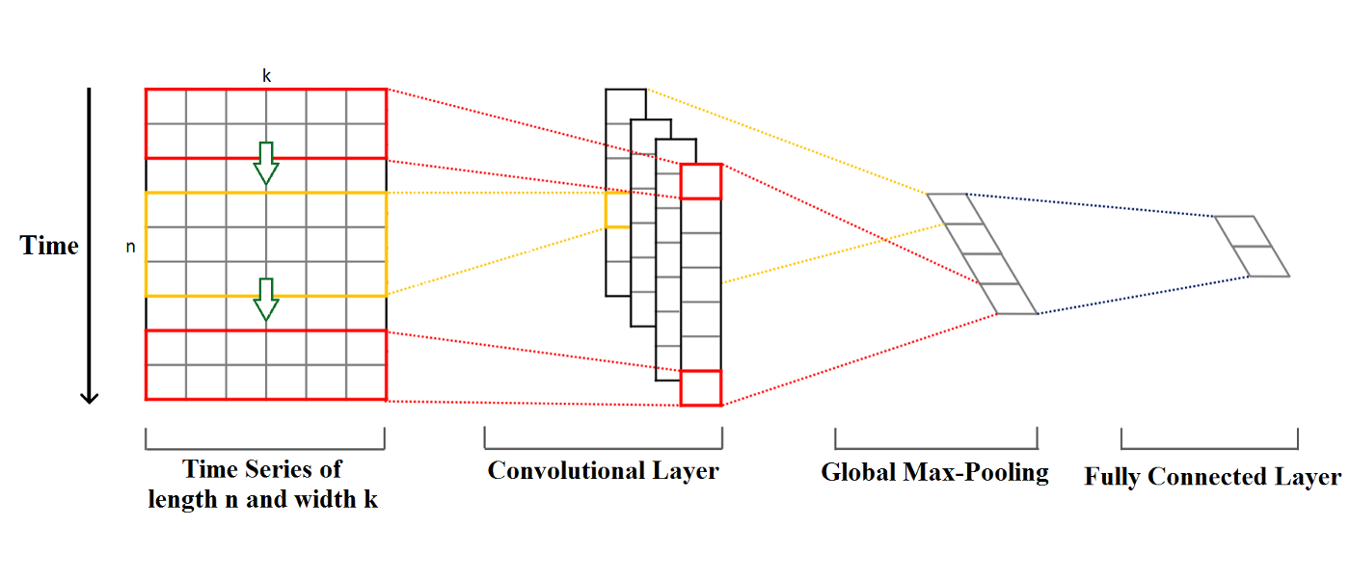
(Temporal) 1D Convolution
1D Convolution Accomplishes Same Goal as 2D
It only considers arrangement of features in one dimension (temporal ordering).
Compresses into shorter sequences, across the entire set of features (just as 2D Conv compresses matrices into smaller matrices, across the entire set of input channels (e.g., RGB).

Slide 18
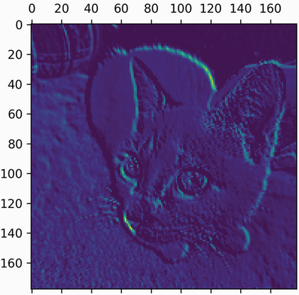
Visualizing What a CNN is Learning
Visualizing Filter Activations in a Layer for a Given Image
For a given layer and input image, we plot the 2D feature map for each channel (filter). Each one will capture independent features of the image – plotting each layer’s activation (output) can show us what features are being identified in the pictures to produce the final prediction.

Slide 19
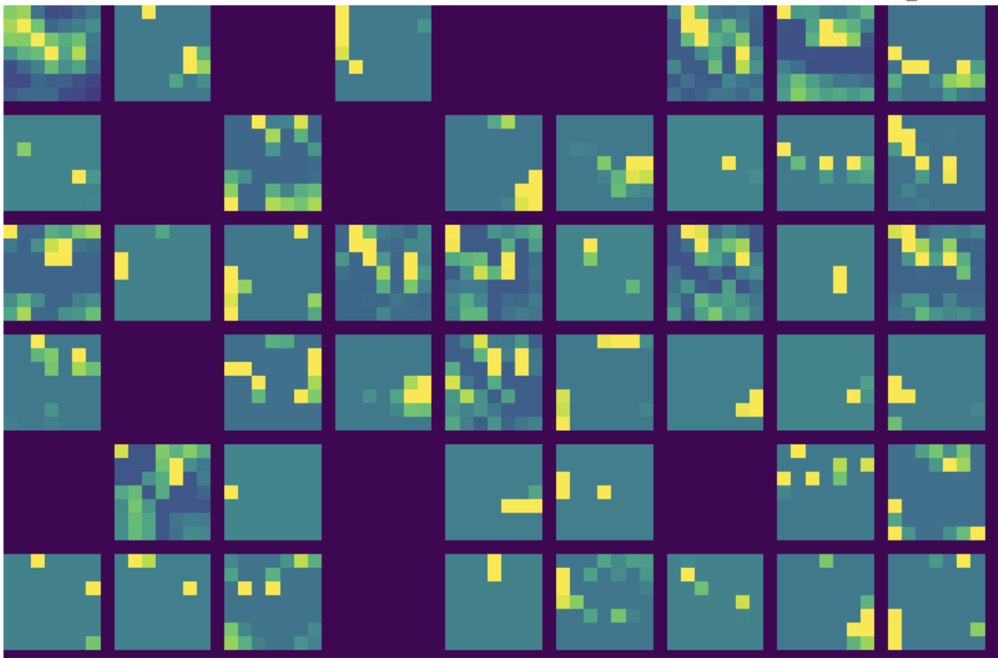
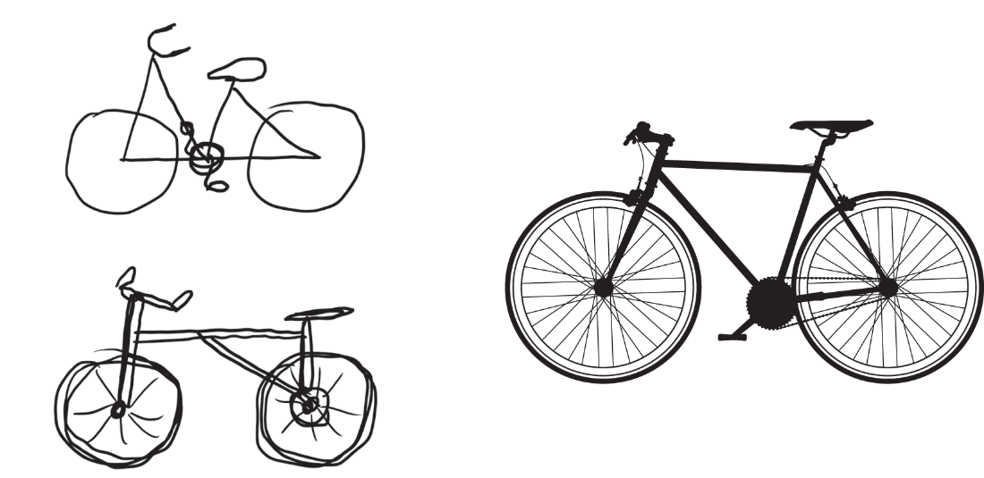
Deeper Feature Maps are Not Interpretable
Feature Maps in Deeper Layers Reflect Abstractions
Moreover, as we go deeper, more filters are not activated at all, implying whatever concept they capture is not present in the image.
Notes:
The book makes the point that these fuzzy abstractions are exactly how we process images mentally too…

Slide 20
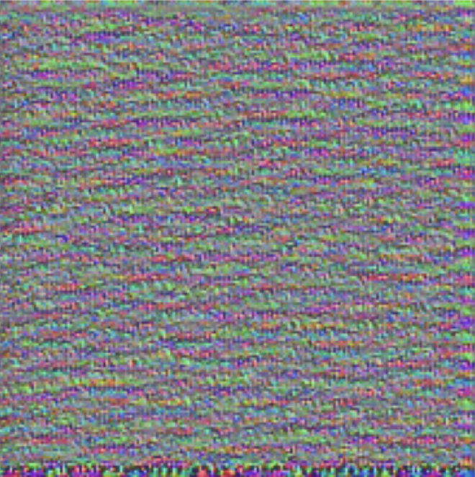
Gradient Ascent
We Learn an Image That Maximally Activates a Filter
We can specify a function that calculates the gradient between a filter’s average output activation and the pixel values of an input image.
We can then learn an image that maximally activates the filter, by updating pixel values, starting with random noise.

Slide 21
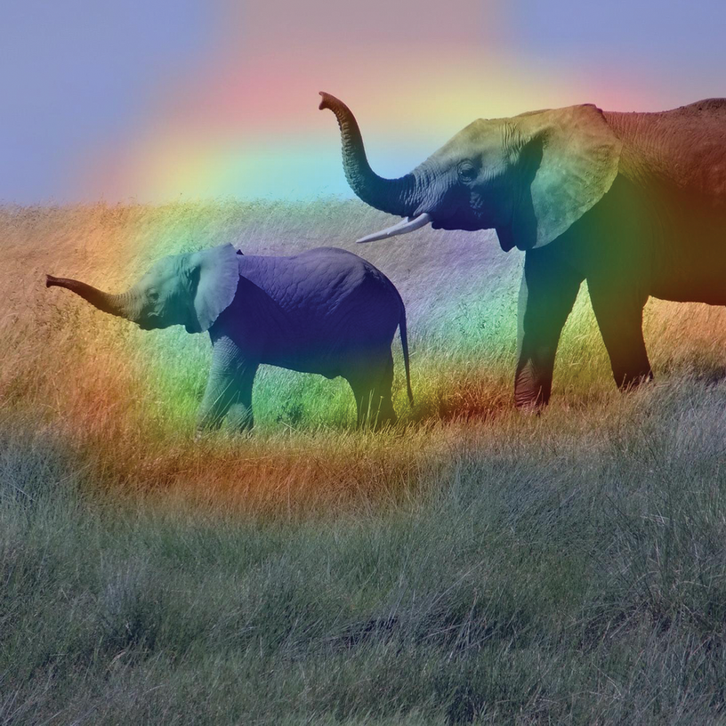
Class Activation Maps
What Pixels Drove a Given Prediction?
Generate a heatmap on the original input image that indicates what ‘components’ (pixels) of the input image most drive the final classification assignment based on ‘steepest’ gradients.
Useful for identifying objects in a particular image too, e.g., when you have an object detector.
Notes:
Note, we will do a simple variant of this later with LIME. SHAP tries to get at something similar as well.

Slide 22
Questions?
Notes:
Weights are not initialized until you “build” the model (or compile it, which will first build).

